Slide 1
Physics of fusion power
Lecture 5: particle motion

Slide 3
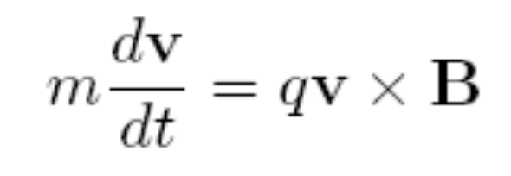
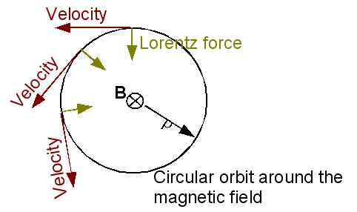
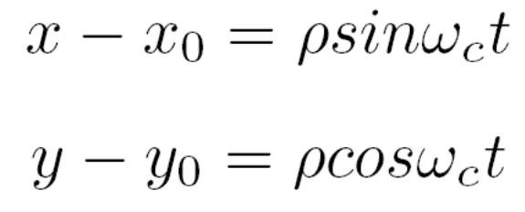
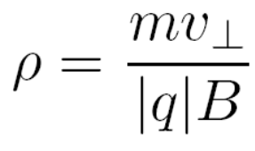
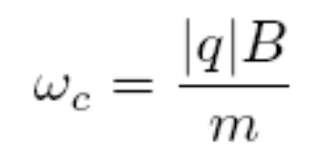
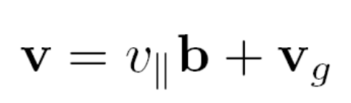
Gyro motion
The Lorentz force leads to a gyration of the particles around the magnetic field
We will write the motion as
The Lorentz force leads to a gyration of the charged particles around the field line
Parallel and rapid gyro-motion

Slide 4
Typical values
For 10 keV and B = 5T. The Larmor radius of the Deuterium ions is around 4 mm for the electrons around 0.07 mm
Note that the alpha particles have an energy of 3.5 MeV and consequently a Larmor radius of 5.4 cm
Typical values of the cyclotron frequency are 80 MHz for Hydrogen and 130 GHz for the electrons
Often the frequency is much larger than that of the physics processes of interest. One can average over time
One can not however neglect the finite Larmor radius since it lead to specific effects (although it is small)

Slide 5
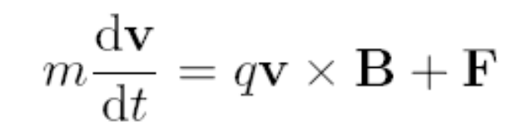
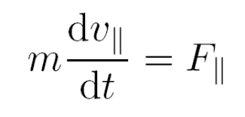
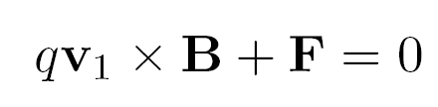
Additional Force F
Consider now a finite additional force F
For the parallel motion this leads to a trivial acceleration
Perpendicular motion: The equation above is a linear ordinary differential equation for the velocity. The gyro-motion is the homogeneous solution. The inhomogeneous solution

Slide 7
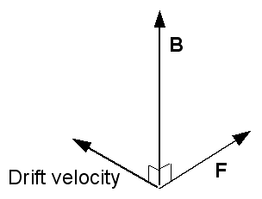
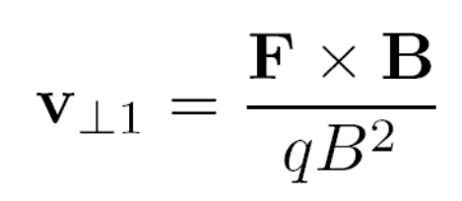
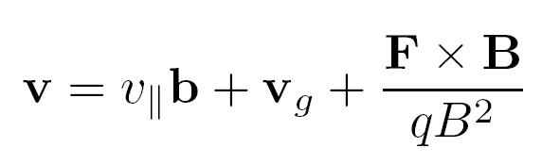
Drift velocity
Inhomogeneous solution
Solution of the equation

Slide 8
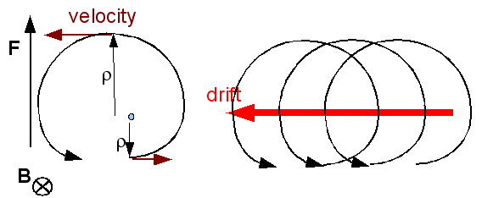

Physical picture of the drift
The force accelerates the particle leading to a higher velocity
The higher velocity however means a larger Larmor radius
The circular orbit no longer closes on itself
A drift results.
Physics picture behind the drift velocity

Slide 9
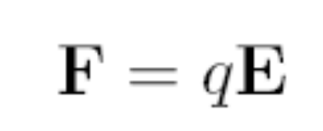
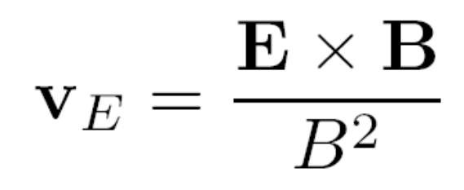
Electric field
Using the formula
And the force due to the electric field
One directly obtains the so-called ExB velocity
Note this drift is independent of the charge as well as the mass of the particles

Slide 10
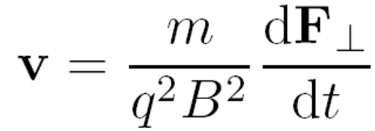

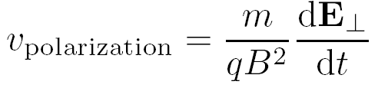
Electric field that depends on time
If the electric field depends on time, an additional drift appears
Polarization drift. Note this drift is proportional to the mass and therefore much larger for the ions compared with the electrons

Slide 11
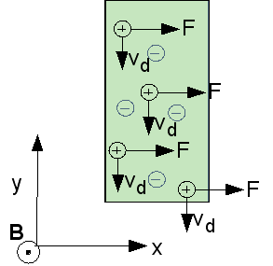
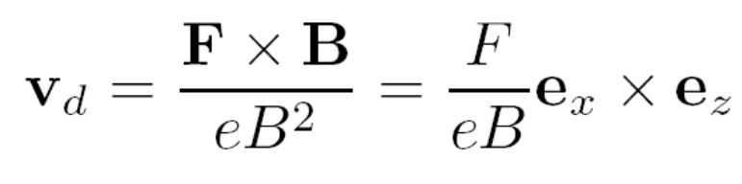
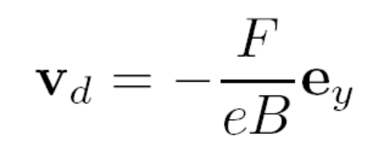
Meaning of the drifts
Assume a Force F on each ion in the x-direction
Electrons are stationary
Drawing of the slab of plasma with a force F on the ions in the x-direction

Slide 12
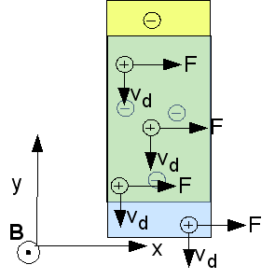

Drift leads to charge separation
The drift of the ions leads to charge separation.
A small charge separation will lead to a large electric field, i.e. a build up of an electric field can be expected
This would lead to a polarization drift
Quasi-neutrality
Drawing of the slab of plasma with a force F on the ions in the x-direction

Slide 13
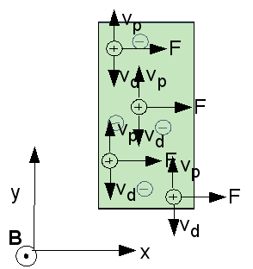
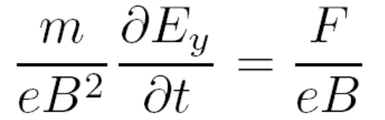
Electric field evolution
The polarization drift balances the drift due to the force
The plasma remains quasi-neutral, and the electric field can be calculated from the polarization drift
Drawing of the slab of plasma with a force F on the ions in the x-direction

Slide 14
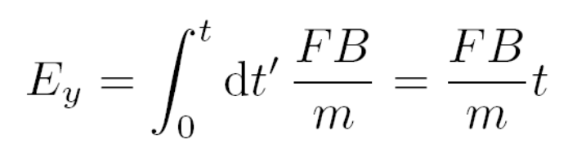
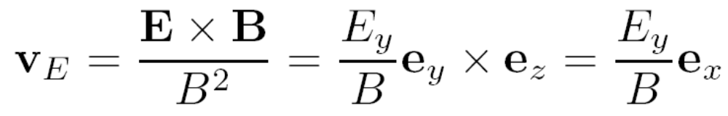
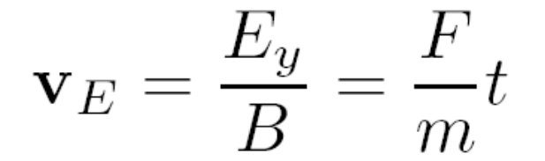
The next drift : The ExB velocity
The electric field evolution
leads to an ExB velocity
Substituting the electric field

Slide 15
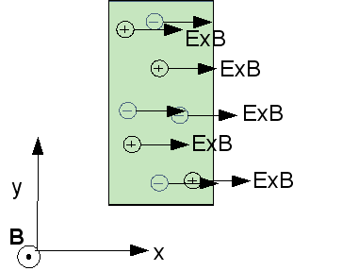
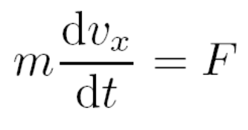
The ExB velocity
The ExB velocity
Satisfies the equation
Chain. Force leads to drift. Polarization drift balances the drift and leads to electric field, ExB velocity is in the direction of the force
Motion due to the ExB velocity

Slide 16
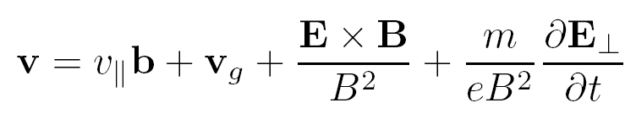
Meaning of the drifts
In a homogeneous plasma
Free motion along the field line
ExB drift velocity. Provides for a motion of the plasma as a whole (no difference between electrons and ions)
Polarization drift. Allows for the calculation of the electric field evolution under the quasi-neutrality assumption. Provides for momentum conservation.
Fast gyration around the field lines

Slide 18
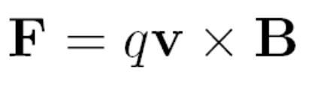
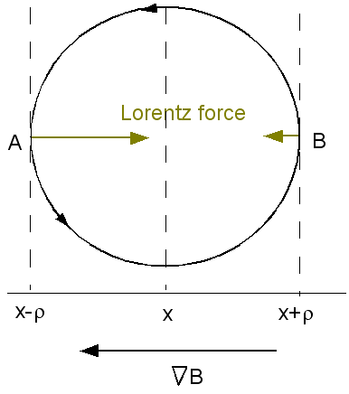
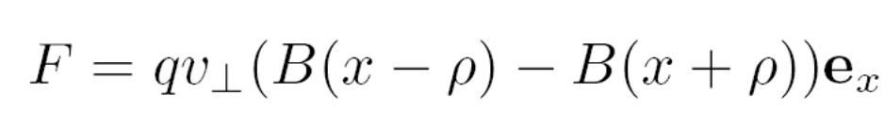
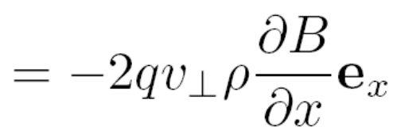
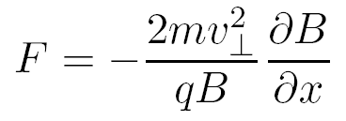
Inhomogeneous magnetic fields
When the magnetic field strength is a function of position the Lorentz force varies over the orbit
Taking two points A and B
Drawing of the Grad-B force

Slide 19
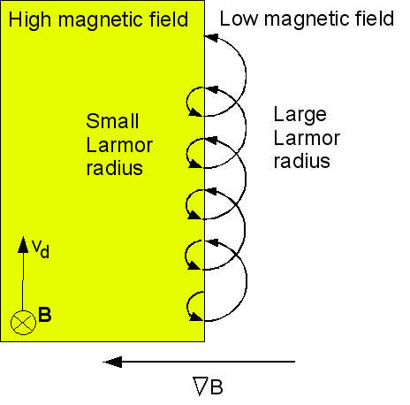
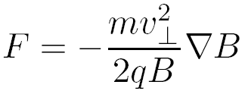
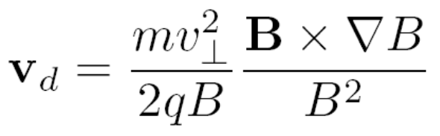
Inhomogeneous magnetic field
Force due to magnetic field gradient is directed such that the particle tries to escape the magnetic field
Leads to the grad-B drift

Slide 20
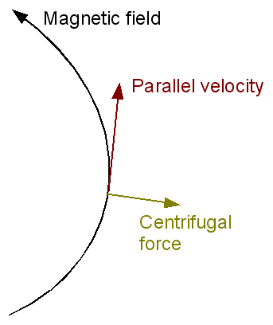
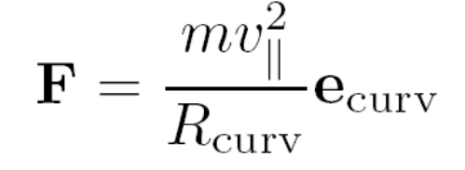
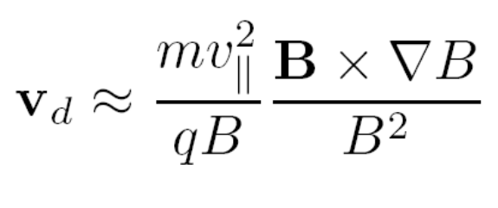
Curvature drift
A particle moving along a curved field line experiences a centrifugal force
For a low beta plasma
Centrifugal force due to the motion along a curved magnetic field

Slide 21
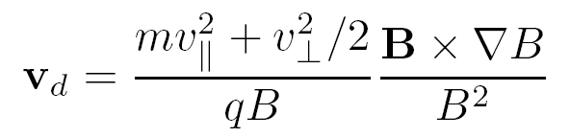
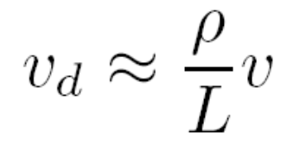
Drifts due to the inhomogeneous field
The drifts due to the inhomogeneous field (curvature and grad-B)
The drift due to the magnetic field in homogeneity is in general much smaller than the thermal velocity
Scales as ρv
Scales as 1/L where L is the scale length of the magnetic field

Slide 22
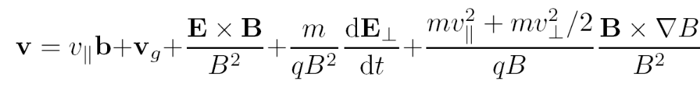
All together ….
Gyration
Grad-B and curvature drift
Parallel motion
Pololarization drift
ExB drift

